Slide 1
Improving the Effectiveness of Counter ISIS Information Operations on Twitter
Brian Fairlie
DAT 6

Slide 2
Goals
Begin to determine variables that are likely to influence a Tweet’s resonance within a target audience:
Windows of opportunity: Determine the brief periods of time during which pro-ISIS audiences are most active on Twitter.
Purpose: By messaging when audiences are most active, property managers can improve the level of impressions that their Tweets earn.

Slide 3
Attaining the Data
Social Media Monitoring Tool
Download the data using a social media monitoring tool, using a Boolean query to set the search parameters.
Data: April 10, 2015
Search string: (#WeWillBurnUSAgain AND سنحرق_أمريكا) AND NOT ("jensan1332 " OR from:jensan1332 OR #TeaParty OR from:trucksHorsesDog OR #TwitterKurds OR #Peshmerga OR "TruckshorsesDog" OR #wakeupamerica OR #tcot OR "22lm22" OR "dsdotar" OR "brassidio" OR "oklacomanche" OR from:HewarMaftuh OR "HewarMaftuh" OR "HewarMaftuh2" OR from:HewarMaftuh2 OR from:brassidio OR "داعش" OR from:herim22_0 OR from:22lm22 OR "Terror_monitor" OR "three husbands" OR #WAKEUPTwitter OR "un altro 11 settembre" OR @SputnikInt OR "threatening another 9/11-style" OR "chan" OR "Daeshcrimes" OR from:DSDOTAR OR from:TheOnlyJewhadi OR "TheOnlyJewhadi" OR "OPISIS" OR from:opantilsls OR "opantilsls" OR "isischan" OR "isis chan" OR "ISISちゃん" OR "daesh" OR "daash" OR "daish" OR #YPG OR "infidelscotsman")

Slide 4
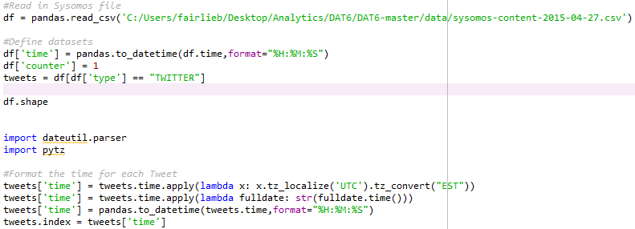
Cleaning the Data
Define the data sets.
Format the time stamps.

Slide 5

Analysis
Sort the various posted times of all of the tweets and group them into 30 minute or one hour blocks, in order to determine which blocks would be the best times to post messages.

Slide 6
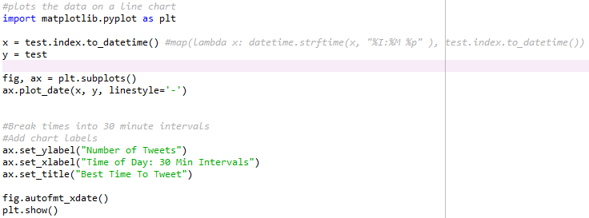
Plot the Time Intervals
Prepare the chart and plot the data in the chart

Slide 7
Write the data to an Excel file

Slide 8
What comes next?
The results of this project will allow me to begin crafting a set of guidelines that will likely increase the resonance of issued Tweets.
Map social networks of pro-ISIS users
Profile communities involved in the conversations.
Determine the prominent narratives for possible counter messaging.
Determine popular hashtags being used within each community.

